Slide 1

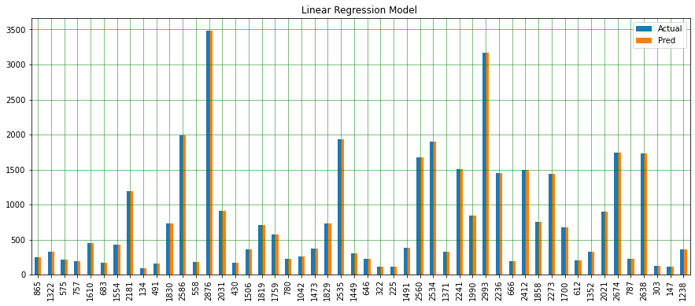
Linear Regression Model Evaluation
Linear Model RMSE (root mean square error) 2.4024554165180363e-13
Linear Model MAE (mean absolute error) 1.938511161746562e-13
Linear Model R2 score 1.0

Slide 2
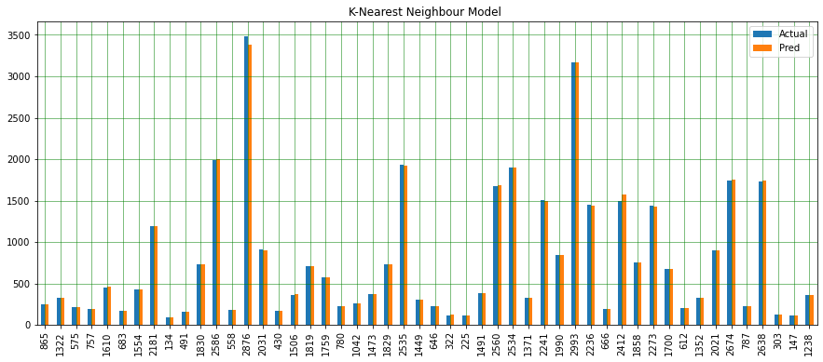
KNN Model Evaluation
KNN Model RMSE (root mean square error) 8.055662406275989
KNN Model MAE (mean absolute error) 3.361844693114426
KNN Model R2 score 0.9999128812353679

Slide 3

SVM Model Evaluation
SVM Model RMSE (root mean square error) 0.04632123250742317
SVM Model MAE (mean absolute error) 0.04208701205917427
SVM Model R2 score 0.9999999971194898

Slide 4
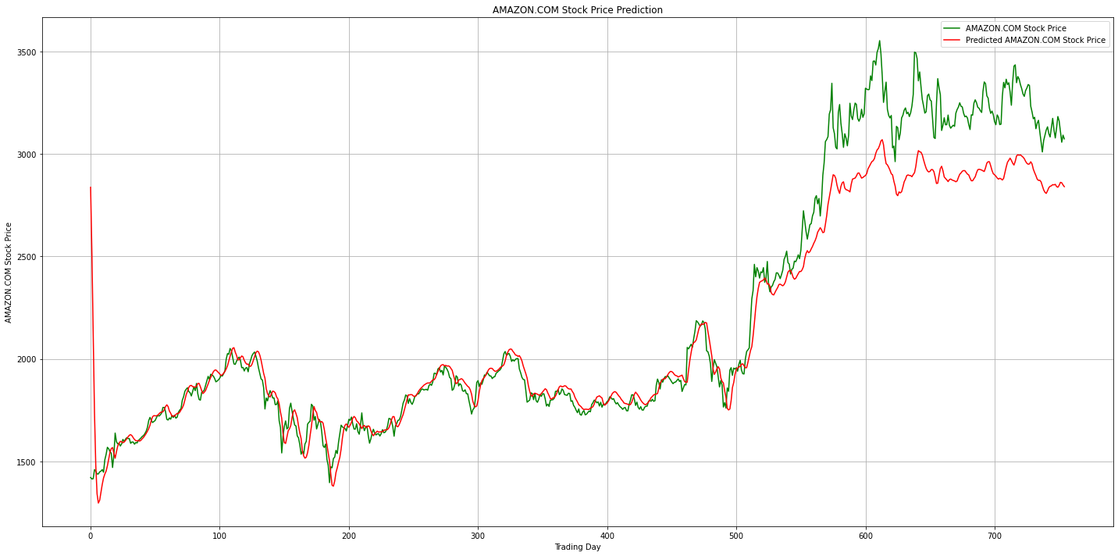
RNN-LSTM Model Evaluation
LSTM Model RMSE (root mean square error) 186.0728774117609
LSTM Model MAE (mean absolute error) 116.32627308826572
LSTM Model R2 score 0.911753314248435

Slide 5
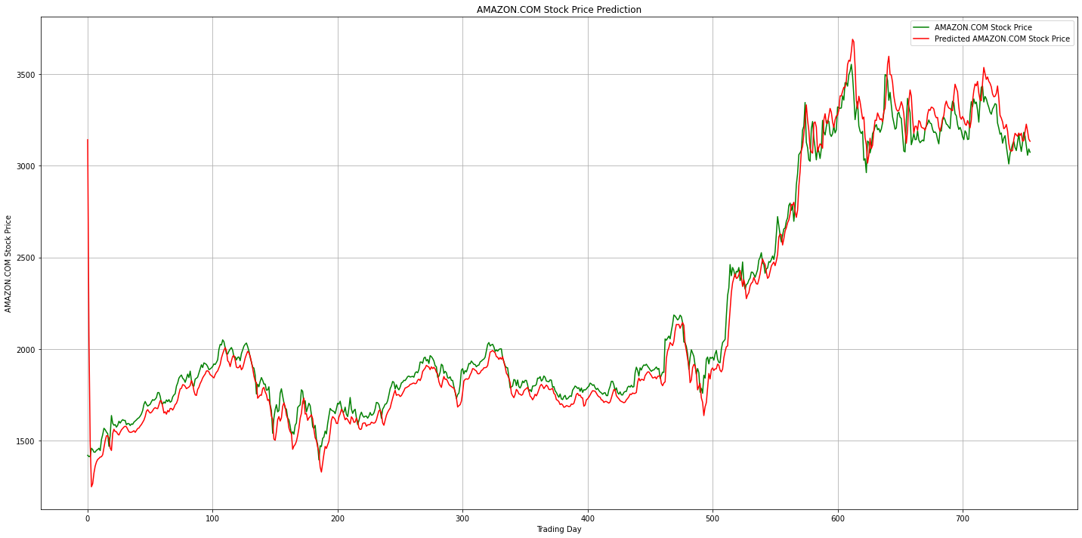
Improved RNN-LSTM Model Evaluation
LSTM Model RMSE (root mean square error) 104.88462191329695
LSTM Model MAE (mean absolute error) 68.07768667865273
LSTM Model R2 score 0.9719614280456601

Slide 6
Combined Evaluation Metrics RSME
RMSE ( Root Mean Square Error)
Linear Model RMSE 2.4024554165180363e-13
SVM Model RMSE 0.04632123250742317
KNN Model RMSE 8.055662406275989
LSTM Model RMSE 186.0728774117609
LSTM Model (Improved) RMSE 104.88462191329695

Slide 7
Combine Evaluation Metrics MAE
MAE (Mean Absolute Error)
Linear MAE 1.938511161746562e-13
SVM Model MAE 0.04208701205917427
KNN Model MAE 3.361844693114426
LSTM Model MAE116.32627308826572
LSTM Model (Improved) MAE 68.07768667865273

Slide 8
Combine Evaluation Metrics R2
R2 or R-Squared Score
Linear Model R2 score 1.0
SVM Model R2 score 0.9999999971194898
KNN Model R2 score 0.9999128812353679
LSTM Model R2 score 0.911753314248435
LSTM Model (Improved) R2 score 0.9719614280456601

Slide 9
Model Evaluation Conclusion
At first a reasonable conclusion to achieve is that the Linear models have performed better.
However I prefer the RNN-LSTM models. My reason is the following:
The traditional Linear models I find to be static whereas the RNN-LSTM Time Series Forecasting which is a deep learning model is rather dynamic. It is an unsupervised model which attained prediction by learning from the past all by itself.

Slide 10
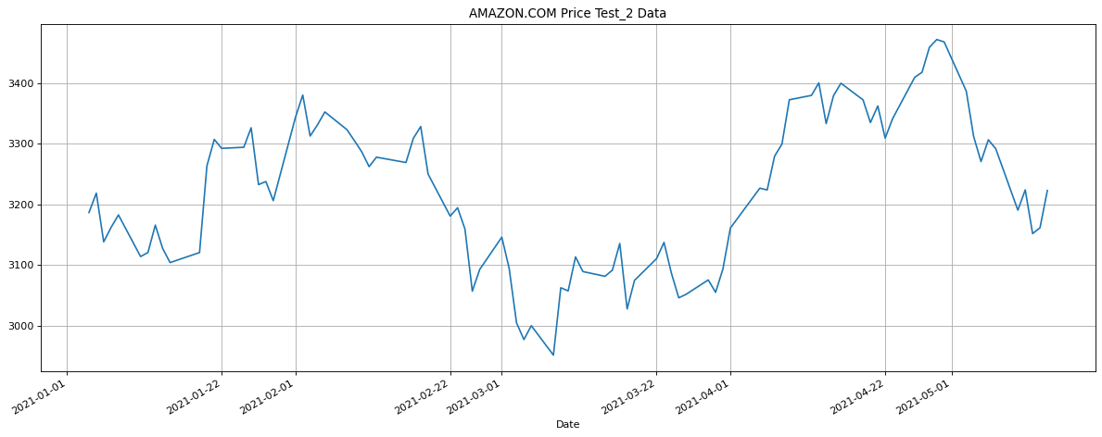
Looking at RNN-LSTM Model Testing New Data
I recommend the RNN-LSTM Model because it is my favorite and because it is an unsupervised model.
I deployed it using a new set of more current historical test data .
The new test raw data is form January 02, 2021 to May 15, 2021

Slide 11
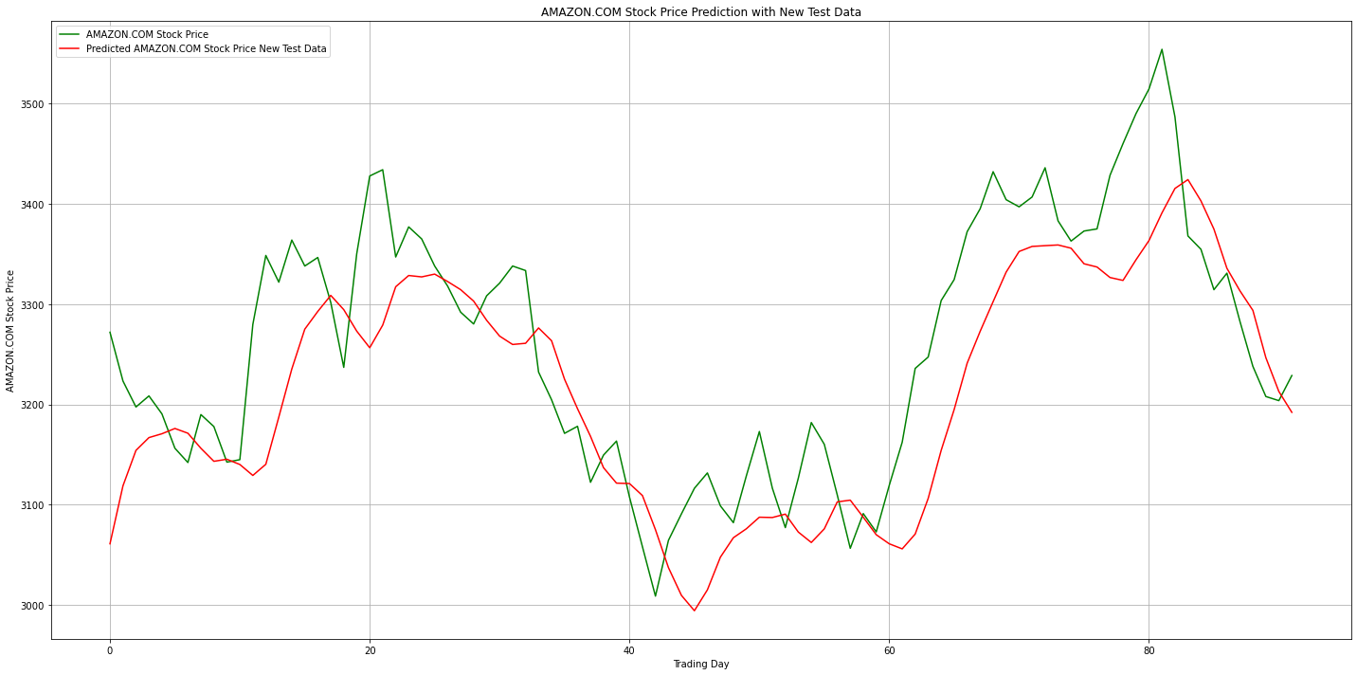
Making Prediction Using New Test Data
Visualizing The New Result Based on New Test Data for RNN-LSTM Model

Slide 12
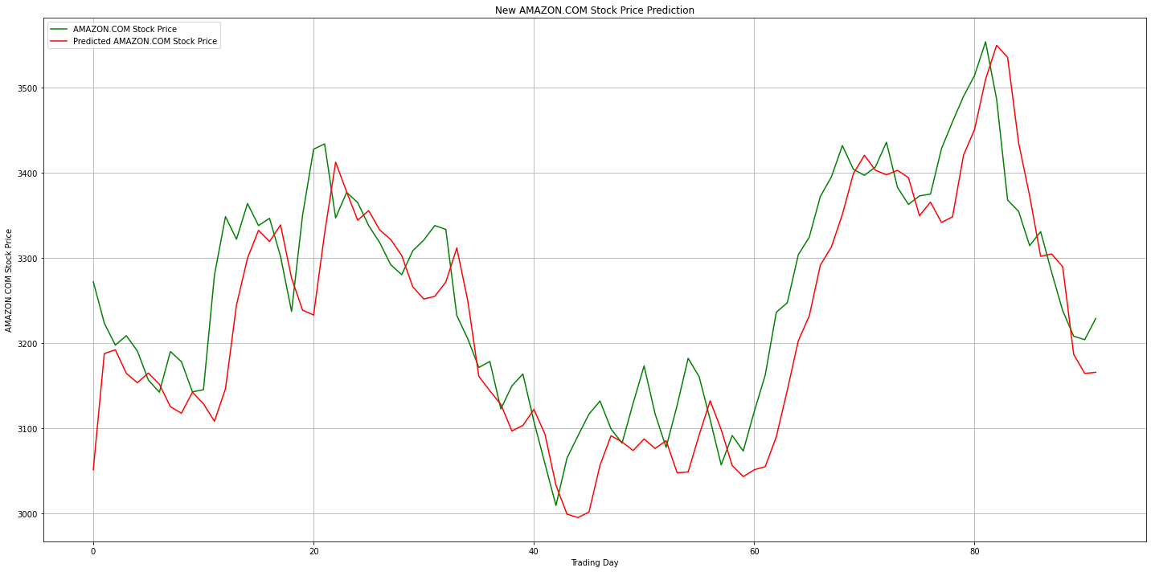
Making Prediction Using New Test Data
Visualizing Result of New Test Data for The RNN-LSTM (Improved) Model

Slide 13

Conclusion
I selected 4 predictive models to work with where 3 of them are categorized as Linear models and one is a Time series forecasting model.
Like an analyst at JP-Morgan said "Prediction is a hard business" . I agree because yesterday's events may give you a glimpse of the future but there are always other unknowns you cannot compute.
As you saw all the models tested well. My preference of the RNN-LSTM Time Series Forecasting Model is based on the fact that it is a recurrent neural network deep learning model and it is unsupervised. This is a branch of machine learning that will take us far where artificial intelligence is concerned.
If I have to select one of the Linear models it would be the Support Vector Machine(SVM) because it did well enough with prediction analysis.

